Slide 1
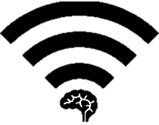

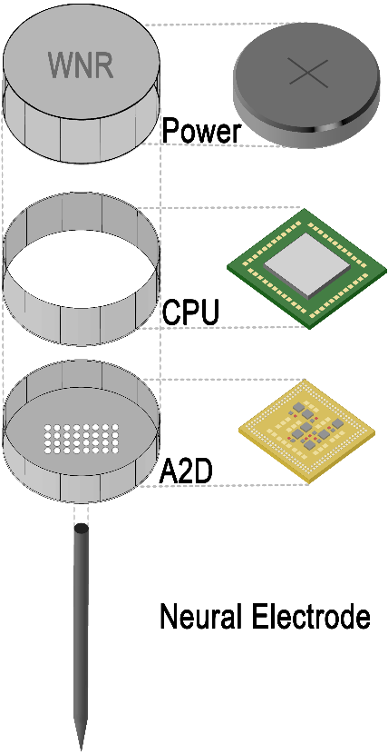
Energy-Efficient High-Throughput Wireless Transmission of Multi-Channel Neural Signals
Yuan Gao, Xin Huang, Tingkai Liu, Stephen Xia
Project Objective for Team Wireless Neural Recorder(WNR)
To develop an array of small, secure, high-throughput, low-power Wireless Neural Recorder(WNR) caps that can be screwed independently onto ECoG electrode for wireless transmission of neural data.
Engineering Design for a Single WNR Cap
Assembly Diagram
16 Data Channels
1K Samples/sec
8 Bits/Sample
Total: 128 Kbit/s
Intan RHD2132
Specialized Neural Recording with Protective Circuitry
NanoVolt Data Sampling Precision
Nordic NRF52
Powerful ARM Cortex-M4 Processor
Data Buffering and Compression
Nordic NRF52
128 bit AES Encryption
1 Mbit/s Bandwidth
< 6mA Power Consumption
Controls & Communicates with all WNR units
Real-time Neural Data Collection and Presentation

